Slide 1

The Way of the Program
Mina Gabriel

Slide 2
What Does it Mean “To Program”?
Today computers became irreplaceable we all us them to solve problems at the workplace, looking for driving directions, communicate with others.
Only few people know how computers really works.
In reality it is not the computer but the program – the software- which run on them, that matter. It is the software that makes computers valuable to the end-user.

Slide 3
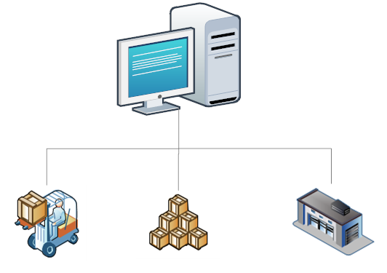
How Do Computers Process Information?
In order to understand what it means to program, we can roughly compare computers and their OS to a large factory with three areas, “workshop, Warehouse and Transportation system”

Slide 4
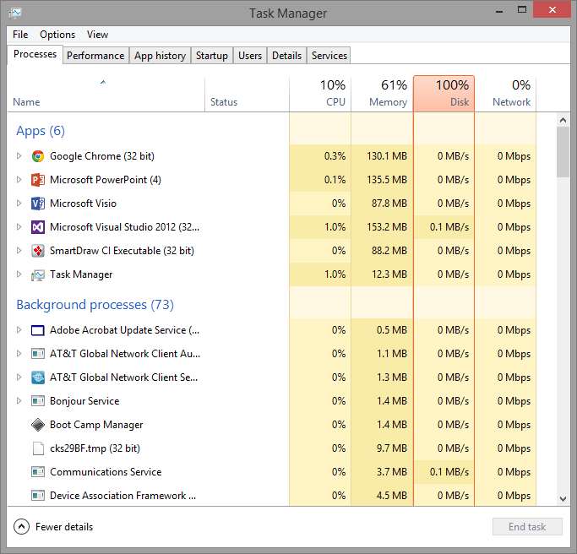
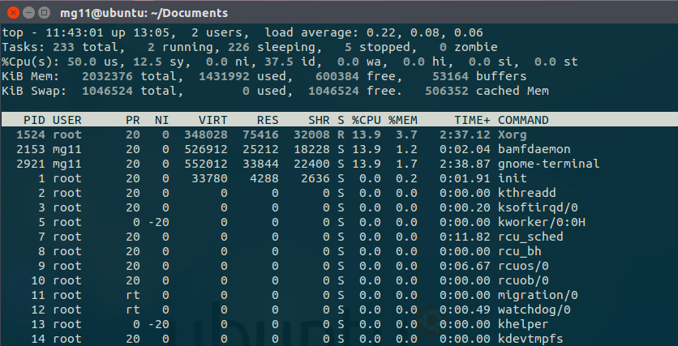
Processes can be defined as programs that are being executed within a computer system.
There are many process running on a computer, and they represent the workshop and production lines in a factory.
You can check processes running on your computer:
Windows:
Right-click taskbar.
Select Task Manager.
If not selected click Processes tab.
Linux: top command + Enter

Slide 5
The Essence of Programming.
The essence of programming is to control the work of the computer on all levels.
This can be done with the help of “orders” and “Command” from the programmers, also Known as Programming Instructions.
To Program means : to organize the work of the computer through sequence of instructions.
These commands are given in written forms and implicitly followed by the computer.

Slide 6
Computer Algorithm
To Make a computer do something you will have to write a computer program, the program tell the computer step by step exactly what to do and when, the computer then “Executes” the program following each step to accomplish the end goal.
When you tell the computer what to do, you will also need to tell the computer How it’s going to do it, that’s where computer Algorithms come in place.

Slide 7
Example : let’s say you have a friend arriving at the airport and need to get to your house
Rent a car – algorithm :
Go to the rent car place
Rent a car
Follow directions to my house
Take a taxi – algorithm :
Go to the taxi stand
Get in to the taxi
Give the driver my address
The previous two algorithms accomplish the same goal, but each algorithm is doing it in a completely different way, each algorithm has a different cost and different time frame – renting a car will take longer time than taking a taxi-

Slide 8
Exercise Write an Algorithm for the previous example that will save your friend some money.

Slide 9

Computer language is more exacting and more limited than English.
If programming languages lack the subtleties of human language, human language cannot match the precision of computer-speak.
Try, for example, to describe a simple spiral without using your hands. It's impossible in English.
But because math is an integral part of computer languages, those languages cannot only describe a spiral but also can provide the instructions to create an image of that spiral on a display or printer.

Slide 10
Programmers
Are people who create these instruction – Algorithms – like what you just did, but to control computers.
These instructions are called programs.
Programmers uses different kinds of programming languages.
Each language is controlling the Computer in a different level.
High Level :
Machine Language
Assembly Language
Low Level :
Visual Basic
C#
PHP
Java
Python
JavaScript and others

Slide 11
On the lowest level is machine language. This is a series of codes, represented by numbers (ones and zeros), used to communicate directly with the internal instructions of the PC's microprocessor.
Luckily, we don't have to do it. Programs called interpreters and compilers translate commands written in higher-level languages into machine language.

Slide 12
Stages in Software Development
Gathering information.
Planning and preparing the architecture and design.
Implementation.
Product testing.
Deployment and operation.
Technical support.

Slide 13
Gathering the Requirements
In the beginning, only the idea for a certain product exists. It includes a list of requirements, which define actions by the user and the computer.
The requirements for the product are usually defined in the form of documentation, written in English or any other language. There is no programming done at this stage. The requirements are defined by experts, who are familiar with the problems in a certain field. They can also write them up in such a way that they are easy to understand by the programmers. In the general case, these experts are not programming specialists, and they are called business analysts.

Slide 14
Planning and Preparing the Architecture and Design
After all the requirements have been gathered comes the planning stage. At this stage, a technical plan for the implementation of the project is created, describing the platforms, technologies and the initial architecture (design) of the program.
According to the requirements, the following parts are chosen:
The type of the application – for example console application, desktop application
The programming language most suitable for the implementation – for example C#, Java, PHP, Python, Ruby, JavaScript or C++ …
The technologies that will be used: platform (Microsoft .NET, Java EE, LAMP or another), database server (Oracle, SQL Server, MySQL, NoSQL),reporting technologies (SQL Server Reporting Services, Jasper Reports or another)

Slide 15
The development frameworks that will simplify the development, e.g. ASP.NET MVC (for .NET), Knockout.js (for JavaScript), Rails (for Ruby), Django (for Python) and many others.
The number and skills of the people who will be part of the development team (big and serious projects are done by large and experienced teams of developers)
The development plan – separating the functionality in stages, resources and deadlines for each stage.

Slide 16
Implementation
The stage, most closely connected with programming, is the implementation stage. At this phase, the program (application) is implemented (written) according to the given task, design and architecture. Programmers participate by writing the program (source) code. The other stages can either be short or completely skipped when creating a small project, but the implementation always presents; otherwise the process is not software development. This book is dedicated mainly to describing the skills used during implementation – creating a programmer’s mindset and building the knowledge to use all the resources provided by the C# language and the .NET platform, in order to create software applications.

Slide 17
Product Testing
Product testing is a very important stage of software development. Its purpose is to make sure that all the requirements are strictly followed and covered. This process can be implemented manually, but the preferred way to do it is by automated test. There are parts of the functionality that are very hard to automate, which is why product trials include automated as well as manual procedures to ensure the quality of the code.
The testing (trials) process is implemented by quality assurance engineers (QAs). They work closely with the programmers to find and correct errors (bugs) in the software. At this stage, it is a priority to find defects in the code and almost no new code is written.
Many defects and errors are usually found during the testing stage and the program is sent back to the implantation stage. These two stages are very closely tied and it is common for a software product to switch between them many times before it covers all the requirements and is ready for the deployment and usage stages.

Slide 18
Deployment and Operation
Deployment is the process which puts a given software product into Production. If the product is complex and serves many people, this process can be the slowest and most expensive one. For smaller programs this is a relatively quick and painless process. In the most common case, a special program, called installer, is developed. It ensures the quick and easy installation of the product. If the product is to be deployed at a large corporation with tens of thousands of copies, additional supporting software is developed just for the deployment. After the deployment is successfully completed, the product is ready for operation. The next step is to train employees to use it.
An example would be the deployment of a new version of Microsoft Windows in the state administration. This includes installation and configuration of the software as well as training employees how to use it.

Slide 19
Technical Support
During the Production process, it is possible that problems will appear. They may be caused by many factors – errors in the software, incorrect usage or faulty configuration, but most problems occur when the users change their requirements.
As a result of these problems, the software loses its abilities to solve the business task it was created for. This requires additional involvement by the developers and the support experts. The support process usually continues throughout the whole life-cycle of the software product, regardless of how good it is.

Slide 20
Software Development Is More than Just Coding
As we saw, software development is much more than just coding (writing code), and it includes a number of other processes such as: requirements analysis, design, planning, testing and support, which require a wide variety of specialists called software engineers. Programming is just a small, but very essential part of software development.

Slide 21
What is Python?
Python is a programming language you will use to learn how to implement software.
allows programmers to express concepts in fewer lines of code than would be possible in languages such as C++, C# or Java.
The language provides constructs intended to enable clear programs on both a small and large scale.

Slide 22

Running Python
One of the challenges of getting started with Python is that you might have to install Python and related software on your computer.
– Python comes preinstalled on most *nix distro-
If you are familiar with your operating system, and especially if you are comfortable with the command-line interface, you will have no trouble installing Python. But for beginners, it can be painful to learn about system administration and programming at the same time.

Slide 23
--version
There are two versions of Python, called Python 2 and Python 3. They are very similar, so if you learn one, it is easy to switch to the other.
In fact, there are only a few differences you will encounter as a beginner.
in this class we will focus on Python 3, but we will include some notes and examples from Python 2 as well.

Slide 24
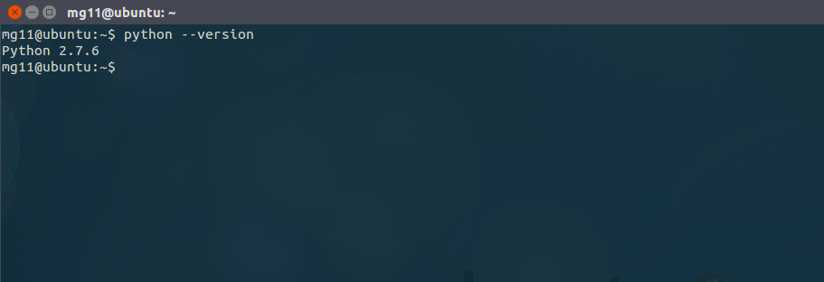
--version
check which version of python you have

Slide 25
Python interpreter
The Python interpreter is a program that reads and executes Python code.
Depending on your environment, you might start the interpreter by clicking on an icon, or by typing python on a command line. When it starts, you should see output like this:
Python 2.7.6 (default, Jun 22 2015, 17:58:13)
[GCC 4.8.2] on linux2
Type "help", "copyright", "credits" or "license" for more information.
>>>

Slide 26
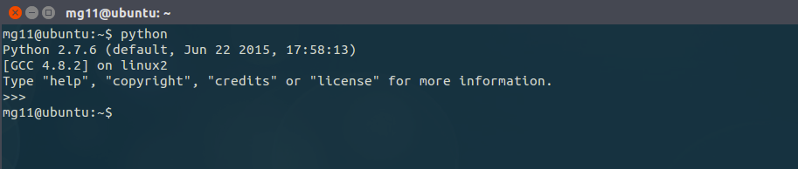
>>>
The >>> is a python prompt indicating the out python interpreter is waiting for us to give it a command.
in programming language a complete command is called a statement.
to start a new python command shell, type python + enter
to quit the python command shell, press CTRL + d

Slide 27
Exercise
open a new terminal
check your python version:
start a new python shell:
type the following line of code:
the interpreter will display the number 2 as a result.
Now you’re ready to get started. From here on, I assume that you know how to start the Python interpreter and run code.
$ python --version
$ python + hit enter
>>> 1 + 1 ‘hit enter’

Slide 28
Hello, World!
Traditionally, the first program you write in a new language is called “Hello, World!”
because all it does is display the words “Hello, World!” In Python, it looks like this:
This statement asks python to display the phrase Hello, World!, python responds on the next line by printing the phrase.
>>> print ‘Hello, World!’

Slide 29
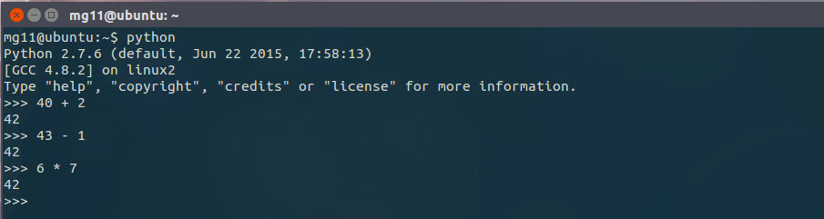
Arithmetic Operators
After “Hello, World”, the next step is arithmetic. Python provides operators, which are special symbols that represent computations like addition and multiplication.
The operators +, -, and * perform addition, subtraction, and multiplication, as in the following examples:

Slide 30
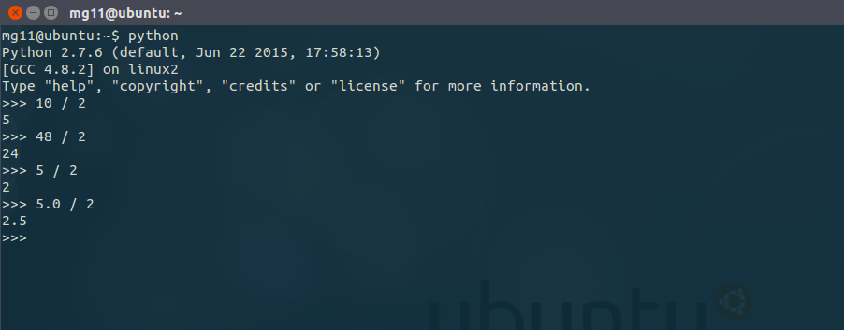
The operator / - forward slash- performs division:
integers – int- are all positive and negative whole numbers, which do not include any fractional or decimal part.

Slide 31
Exercise
use Python to execute the following command lines:
>>> 18 + 12 ‘hit enter’
>>> 1 – 1.5 ‘hit enter’
>>> 12 * 6 ‘hit enter’
>>> 20 / 0 ‘hit enter’

Slide 32
Values and Types
A value is one of the basic things a program works with, like a letter or a number.
Some values we have seen so far are 2, 42.0, and 'Hello, World!'
These values belong to different types:
2 is an integer.
42.0 is a floating-point number. “fractions”
'Hello, World!' is a string. “sequence of character in quotes”

Slide 33
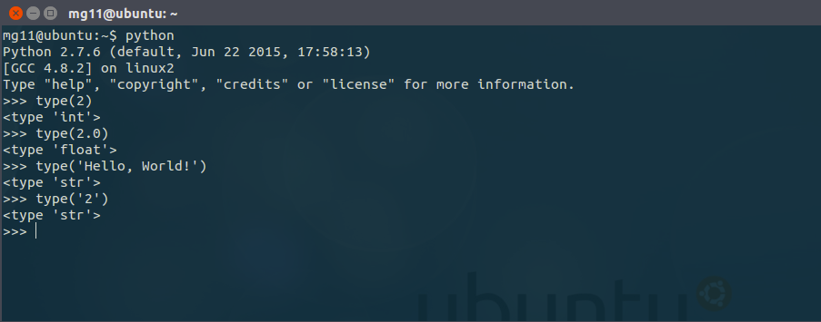
type()
If you are not sure what type a value has, the interpreter can tell you:

Slide 34
Debugging
Programmers make mistakes. For many reasons, programming errors are called bugs and the process of tracking them down is called debugging.
If you are struggling with a difficult bug, you might feel angry, despondent, or embarrassed – your are not the only one who feels like that don’t worry -

Slide 35
The debugging process includes:
Noticing the problems (bugs)
Finding the code causing the problems.
Fixing the code so that the program works correctly.
Testing to make sure the program works as expected after the changes are made.

Slide 36
Glossary
high-level language:
A programming language like Python that is designed to be easy for humans to read and write.
low-level language:
A programming language that is designed to be easy for a computer to run; also called “machine language” or “assembly language”.
interpreter:
A program that reads another program and executes it.
integer:
A type that represents whole numbers.
floating-point:
A type that represents numbers with fractional parts.

Slide 37
string:
A type that represents sequences of characters.
parse:
To examine a program and analyze the syntactic structure.
bug:
An error in a program.
debugging:
The process of finding and correcting bugs.

